Slide 1
Recap: The kinetic-molecular theory’s explanation of adiabatic heating/cooling
When the molecule hits a receding wall (because the container is expanding), the molecule bounces back more slowly; and we just said that slower-moving molecules correspond to lower temperature.

Slide 2
Recap: The kinetic-molecular theory’s explanation of adiabatic heating/cooling
When the molecule hits an advancing wall (because the container is shrinking), the molecule bounces back faster; and we just said that faster-moving molecules correspond to higher temperature.

Slide 3
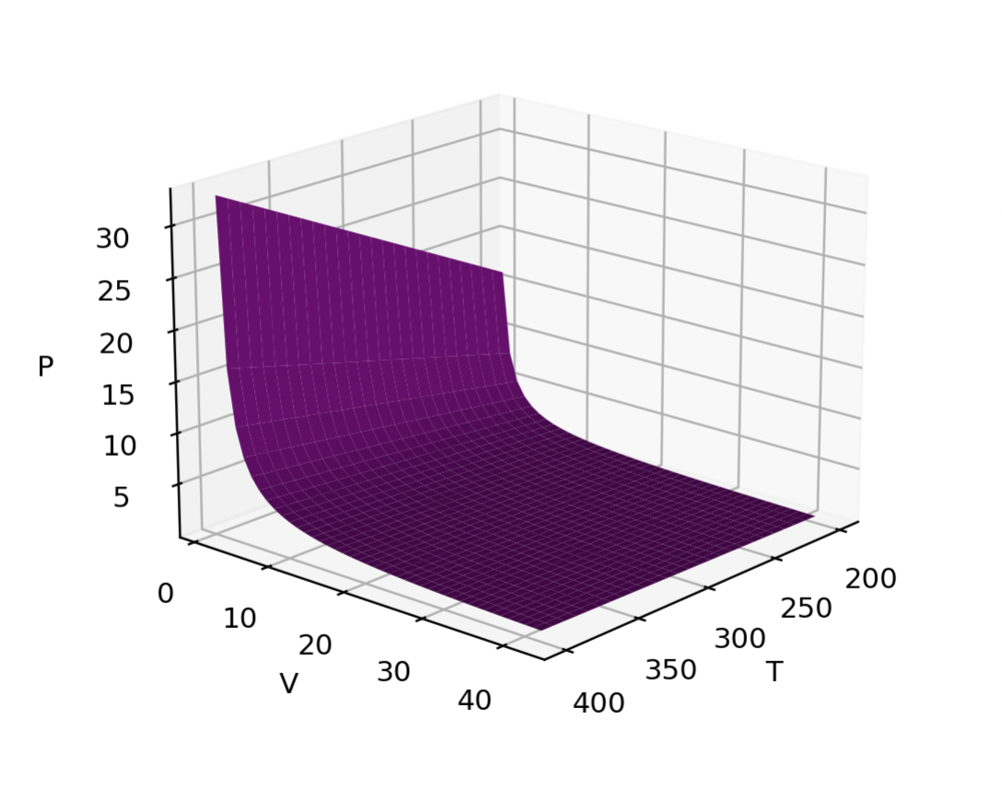
Recap: Thermodynamic surfaces
Here, the state function is the pressure of a gas.
The state space consists of the gas’s temperature and volume.
Each combination of temperature and volume implies a particular pressure:
P(T,V)
This one is an ideal gas, actually. So we can say
P(T,V)=nRT/V

Slide 4
Slicing through a thermodynamic surface: Isotherms and isochores

Slide 5
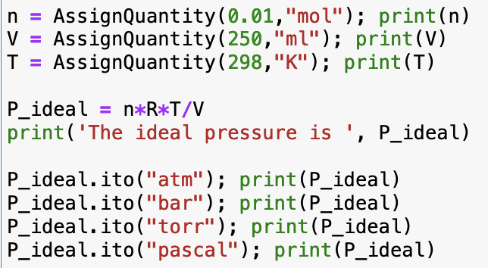
CGI: IntroToPython introduces Pint, the idea of named variables, and unit conversions

Slide 6
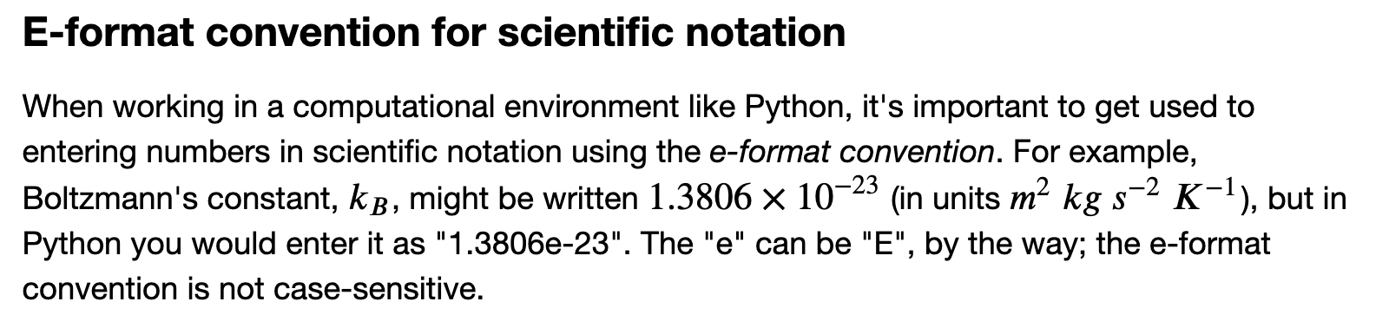
CGI: IntroToPython also introduces the E-format, and the difference between scalars and grids
A scalar = a single number, like a volume or temperature
V
T
A grid = rows and columns of numbers (here, T,V state space)

Slide 7
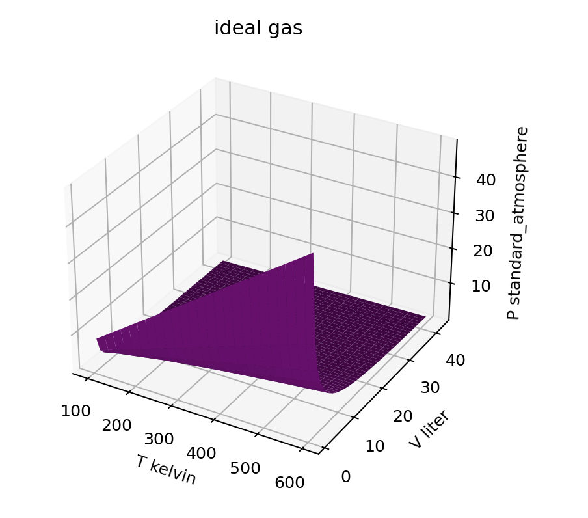
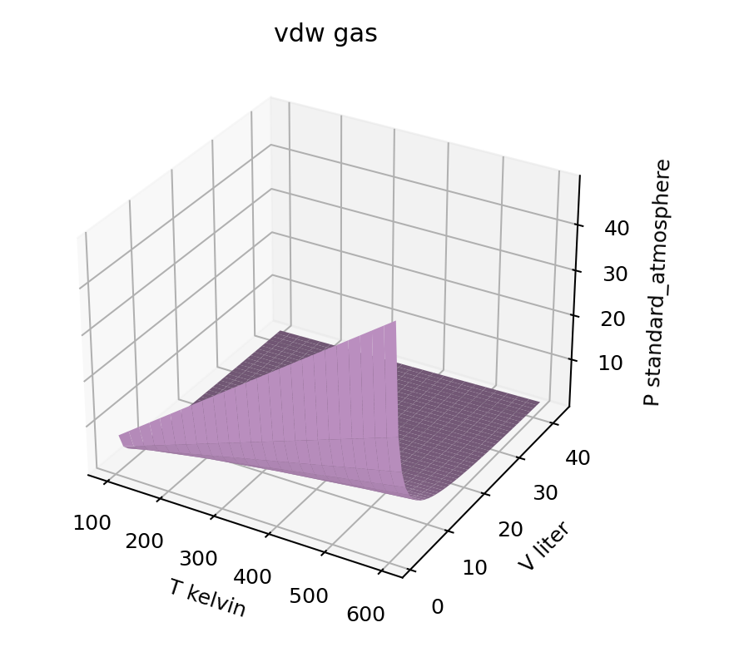

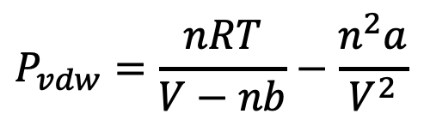
CGI: VisualizingP shows how to visualize thermodynamic surfaces
$$P_{ideal}=\frac{nRT}{V}$$
$$P_{vdw}=\frac{nRT}{V−nb}−\frac{n^{2}a}{V^{2}}$$

Slide 8
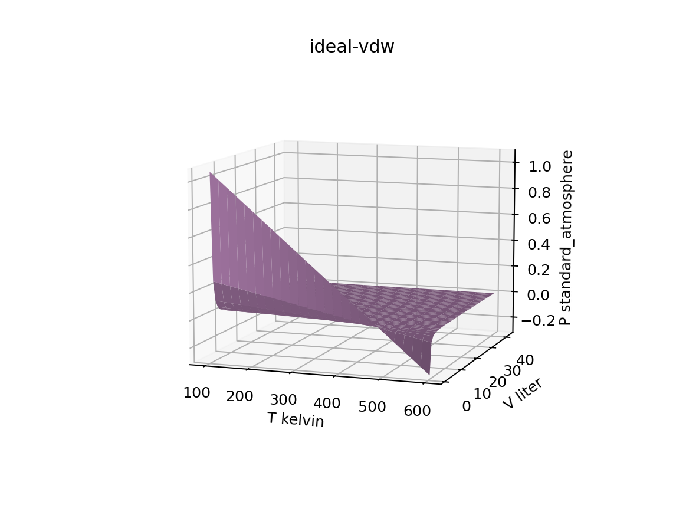


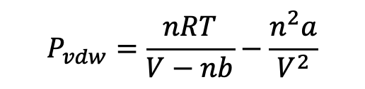
CGI: VisualizingP also shows how we can manipulate (add, subtract) entire surfaces
$$P_{ideal}=\frac{nRT}{V}$$
$$P_{vdw}=\frac{nRT}{V−nb}−\frac{n^{2}a}{V^{2}}$$
$P_{ideal}$- $P_{vdw}$
-
=

Slide 9
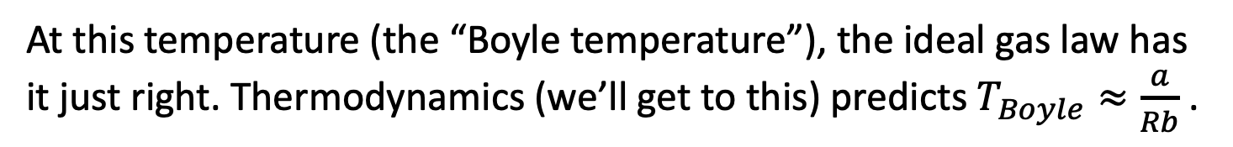

CGI: VisualizingP also shows how we can use visualizations as an analysis tool
Let’s assume vdw’s equation ($P=\frac{nRT}{V−nb}−\frac{n^{2}a}{V^{2}}$) is more accurate than the ideal gas law (a great assumption). Then differences tell us about deficiencies in assumptions of the ideal gas law.
$P_{ideal}$- $P_{vdw}$
Ideal pressure is too big
Ideal pressure is too low
At this temperature (the “Boyle temperature”), the ideal gas law has it just right. Thermodynamics (we’ll get to this) predicts $T_{Boyle}≈\frac{a}{Rb}$ .

Slide 10
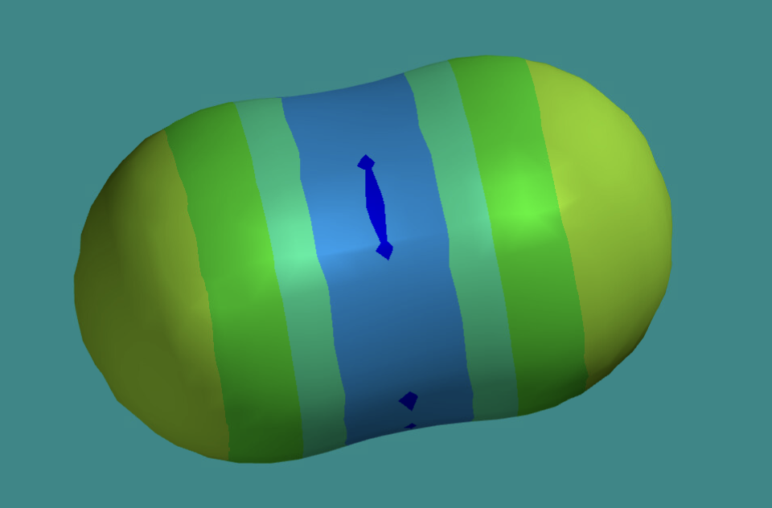
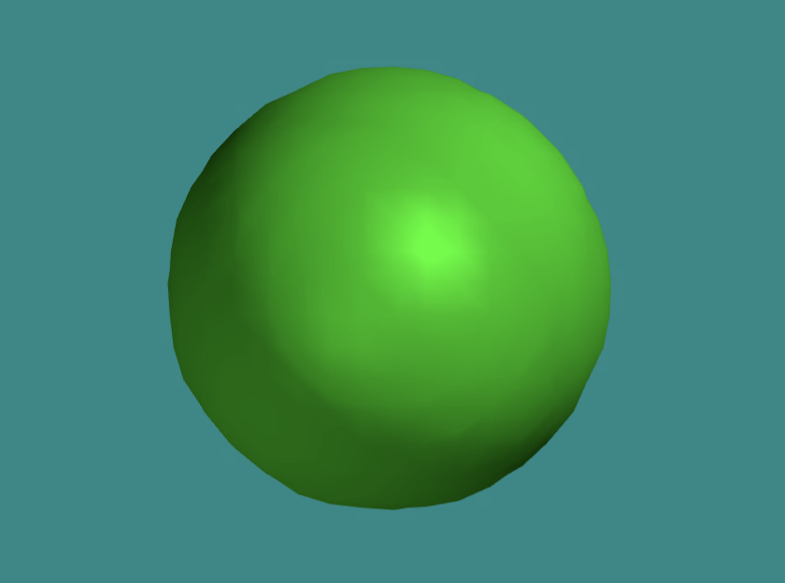

Spartan: Constructing molecules and interpreting electrostatic potential maps
$$CO_{2}$$
Argon atom
What the colors of an electrostatic potential map tell you …
Cool colors (blue) => the surface has a slight positive charge
Warm colors (yellow, red) => the surface has a slight negative charge
Green => the surface has no charge

Slide 11
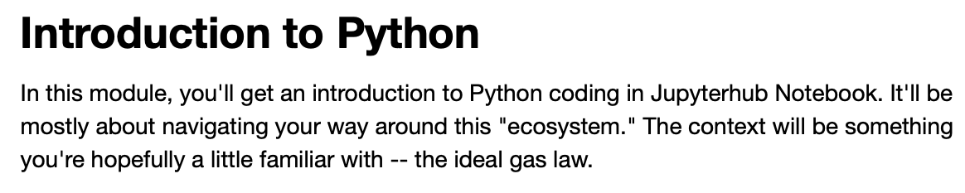
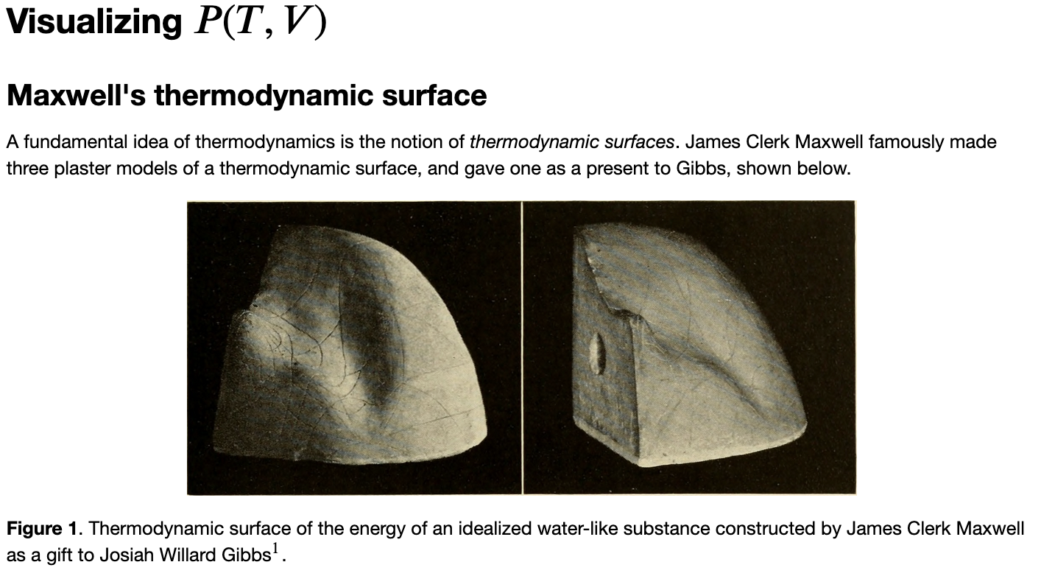

OK, let’s get started (in this order) …
Spartan:
Argon atom
$$CO_{2}$$

